Slide 1
Human Factors and HCI Basics
Based on a PowerPoint presentation
by Laura Leventhal at Bowling Green State U.
Notes:
Preece et al. (1994):Human-Computer Interaction
by Jenny Preece, Yvonne Rogers, Helen Sharp, David Benyon, Simon Holland, and Tom Carey
© 1994 The Open University (Published by Addison-Wesley)
ISBN 0-201-62769-8
Preece et al. (2002):
by Jenny Preece, Yvonne Rogers, and Helen Sharp
© 2002 John Wiley & Sons, Inc.
ISBN 0-471-49278-7
K. D. Eason (1991)
[record from Preece et al. (1994)]
Ergonomic perspectives on advances in human-computer interaction
Ergonomics 34(6):721–741

Slide 2
Goals
Discovering Human Computer Interaction
  What is HCI? What are human factors?
    Why do we need HCI?
    Range of (and priorities for) HCI
    Items of production
  When & how do we apply HCI expertise?
    Approaches
    Concepts, esp. ‘usability’
Notes:
Optimising the human-machine system requires an understanding not only of the machinery itself but also an understanding of
how human beings respond to given situations,
how they achieve their goals using devices,
how they come to choose the particular actions they choose,
how they learn to operate particular artifacts, and so on.
More generally it requires knowing,
why they do what they do when they do it.
The study of why human being do what they do when they do, given certain task objectives is the point of this course.

Slide 3
I. HCI is…
‘a discipline concerned with the design, evaluation, and implementation of interactive computing systems for human use and with the study of major phenomena surrounding them’
ACM SIGCHI Curricula
for Human-Computer Interaction
(Last updated June 2004)
Notes:
Discipline = a branch of knowledge, typically one studied in higher education (Oxford Dictionary of English, Secpnd edition, 2003)
Interactive not mere alternation
ACM SIGCHI Curricula for Human-Computer Interaction
by Hewett, Baecker, Card, Carey, Gasen, Mantei, Perlman, Strong and Verplank
Copyright © 1992,1996 ACM SIGCHI
<URL: http://sigchi.org/cdg/cdg2.html>, Last updated: 2004-06-03

Slide 4
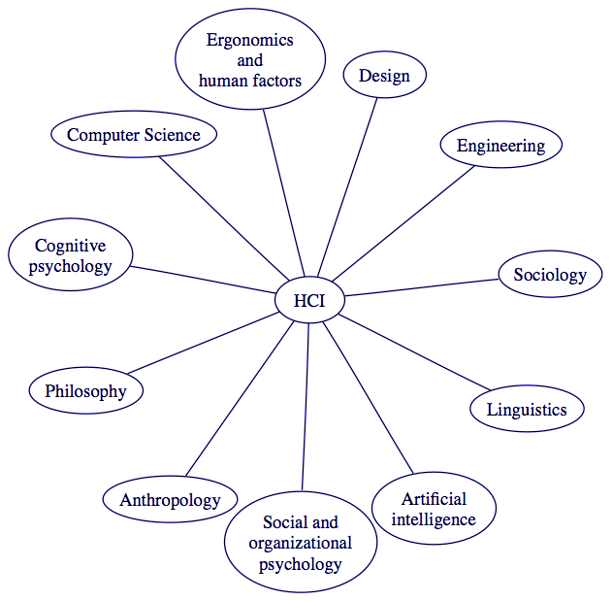
Disciplines that Contribute to HCI*
Notes:
* Redrawn from Figure 2.3 (captioned ‘The disciplines that contribute to HCI’) on p.38 of Preece et al.’s Human-Computer Interaction (1994)

Slide 5
Aim/Purpose
Aim = to provide a good fit between people and the environment
Purpose = to improve work/leisure environments and work practices
Considering safety, satisfaction, & efficiency
Notes:
Purpose of Human Factors:
The purpose of human factors (HF) research and practice is to maximise the safety and ‘healthiness’ of work environments and work practices,
and to ensure the usability of tools, devices and artifacts in general.
More specifically, human factors is concerned with providing a good ‘fit’ between people and their work or leisure environments.
‘Fit’ might be the literal word as with the design of ejector seats for RAF aircraft (e.g. ejector seats designed for average size) or might be more metaphorical in the sense (e.g. designing to complement task activities, e.g. the chapati kitchen). (OHP: showing anthropometrics and kitchens)
The Effects of Stages of Chapati Making and Angles of Body Position on Heart Rate
By Jagjit Kaur Dhesi & Frascille M. Firebaugh
Ergonomics, 1366-5847, Volume 16, Issue 6, 1973, Pages 811 – 815
DOI: 10.1080/00140137308924572
Mobile Smart Kitchen Workstation
By Vishal Thakur
May 2007
A Thesis submitted in partial fulfillment of the requirements for the degree of MASTER OF DESIGN
(DESIGN PROGRAMME, INDIAN INSTITUTE OF TECHNOLOGY, KANPUR)
<URL: http://www.scribd.com/docinfo/3489794?access_key=key-2dhi0d2m4s0ou45hmdtr>
Notably, the ‘fit’ can be made in either direction.
We can ‘fit’ the environment to the person (e.g. by providing adjustable ejector seats to accommodate a range of heights, weights, etc.) or we can fit the person to the environment. (e.g. using people of a certain build, e.g. Suckling airlines in Cambridge).
The two together traditionally make up industrial psychology and used to define occupational psychology (although now the remit of occupational psychology is very large indeed).
[Note ends]

Slide 6
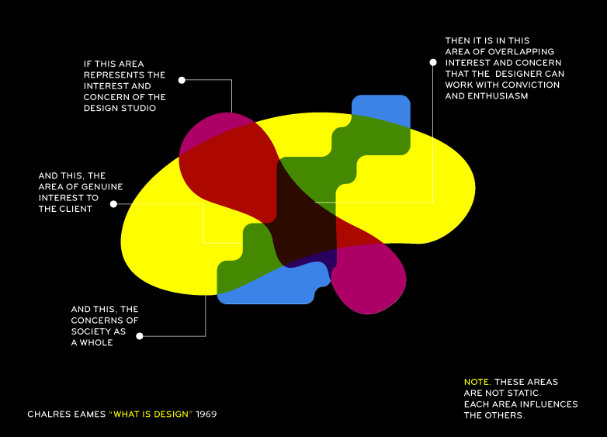
‘What Is Design’ by Charles Eames (1969)
Diagram by James Ellis, Matt Owens, and Jason Gnewikow of the art and design collective Athletics. Permission for use in class (not for distribution) given by telephone by James Ellis
at 14:00 Fri 10 Aug 2012 to Jamie Blustein.

Slide 7
‘What Is Design’ by Charles Eames (1969)
Diagram by James Ellis, Matt Owens, and Jason Gnewikow of the art and design collective Athletics. Permission for use in class (not for distribution) given by telephone by James Ellis
at 14:00 Fri 10 Aug 2012 to Jamie Blustein.

Slide 8
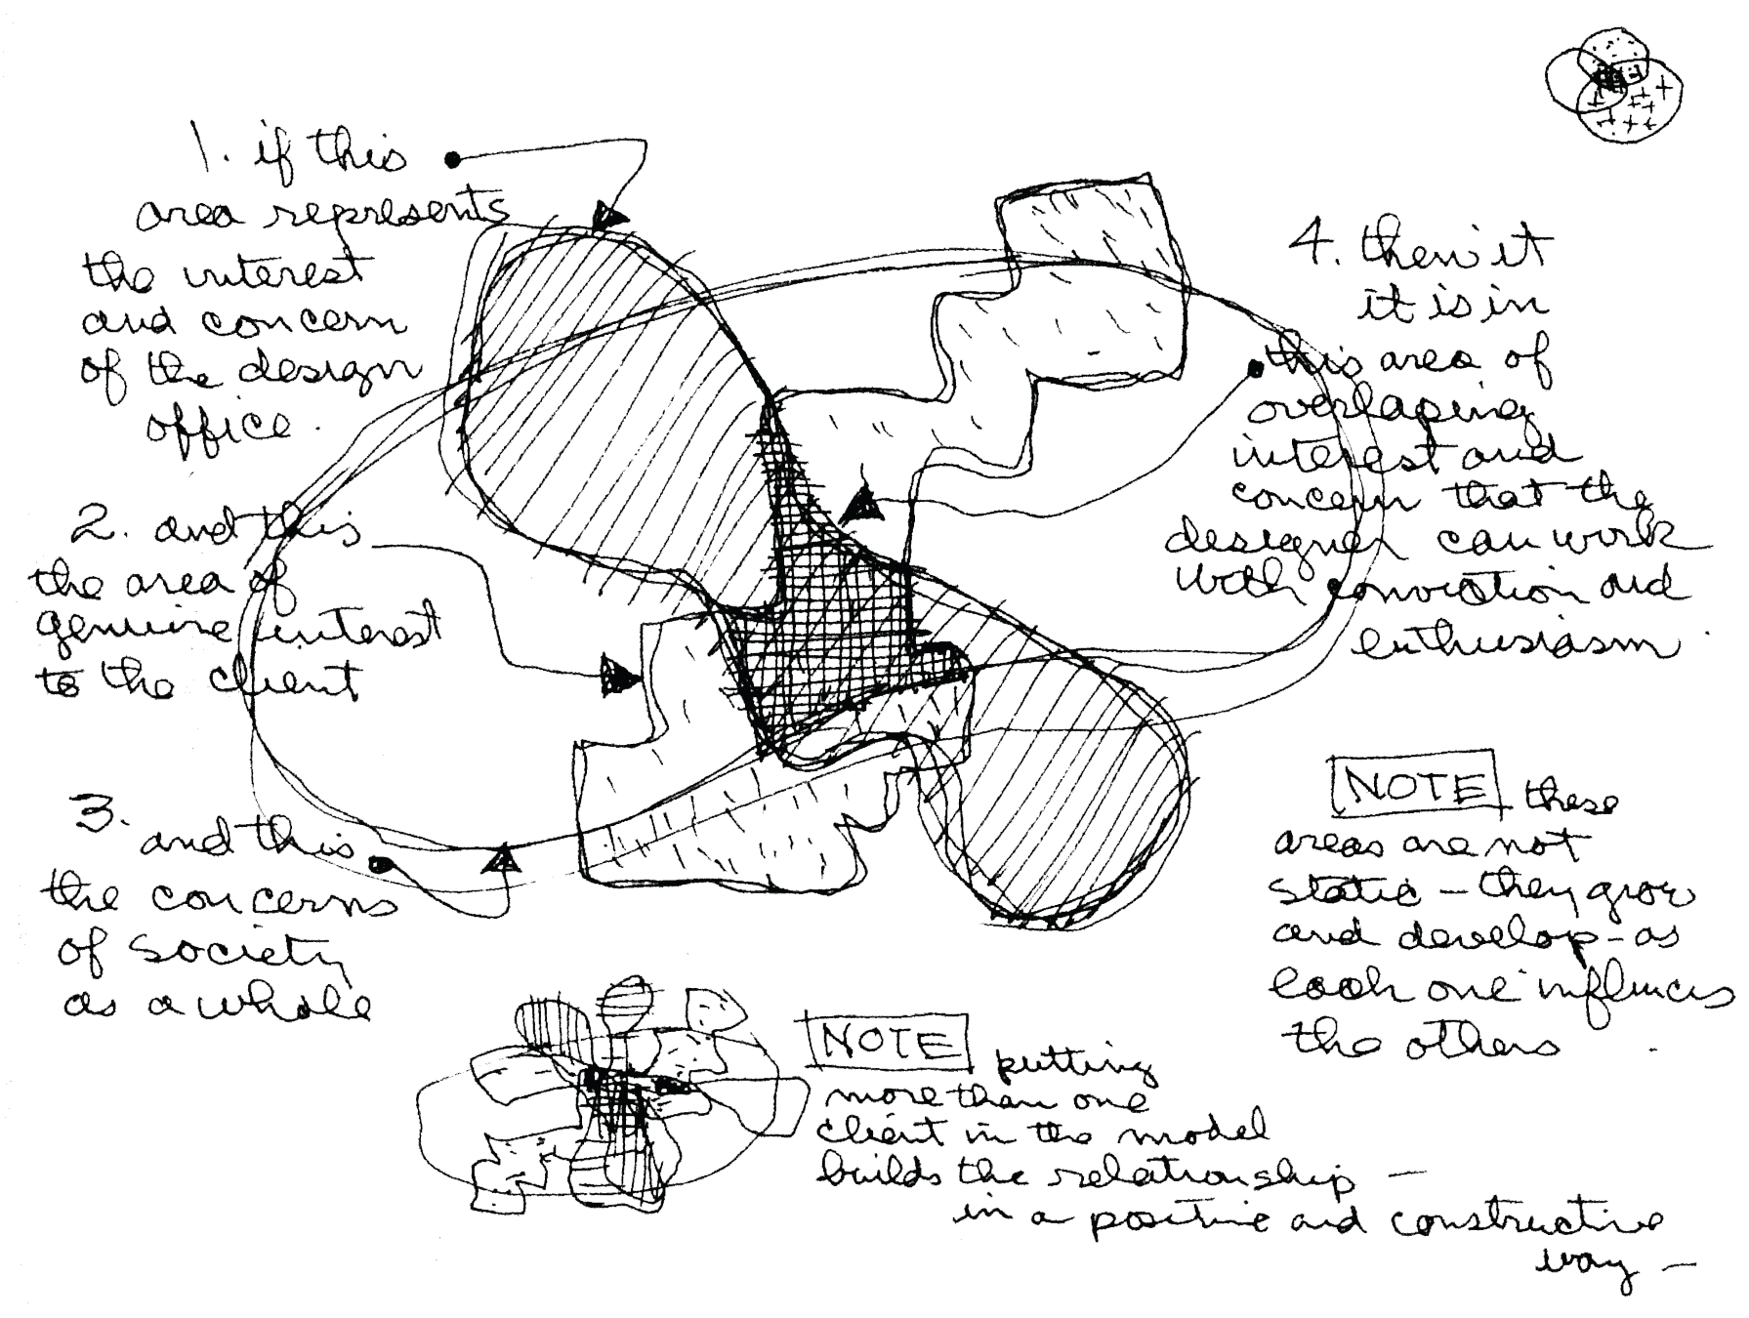
‘What Is Design’ by Charles Eames (1969)

Slide 9
Why do we need HCI?
Over 50% of program code is for UI
Users are more demanding than ever
  See Don Norman’s graphs
Why waste user’s time? We are all committed to quality in coding, why not in UIs and human factors too?
Safety

Slide 10
Change from Tech-driven to Consumer-driven Products
From The Invisible Computer by Don Norman
  Figures 2.2 & 12.1
  ‘When technology reaches the point that it satisfies user needs, consumers no longer seek the best technology; they seek the most convenient one, the one with the most satisfactory user experience, the lowest cost, and the highest reliability.’ (p.251)
Notes:
Quotation is from caption to Figure 12.1 (on page 251).

Slide 11
Needs-Satisfaction Curve of a Technology
Figure redrawn from Norman.
Adapted from Christensen.
Transition point where technology delivers basic needs
Excess Quality
Level of performance required by typical users
Product
Performance
Unfilled Need
Technology is ‘good enough’ and therefore irrelevant. User experience dominates.
Time
High Technology
Consumers want more technology & better performance
Consumer Commodity
Consumers want convenience, reliability, low cost, …
Notes:
Animation based on Figure 2.2 (p. 32) of Norman (see next note (which accompanies the scanned version) for citation).

Slide 12
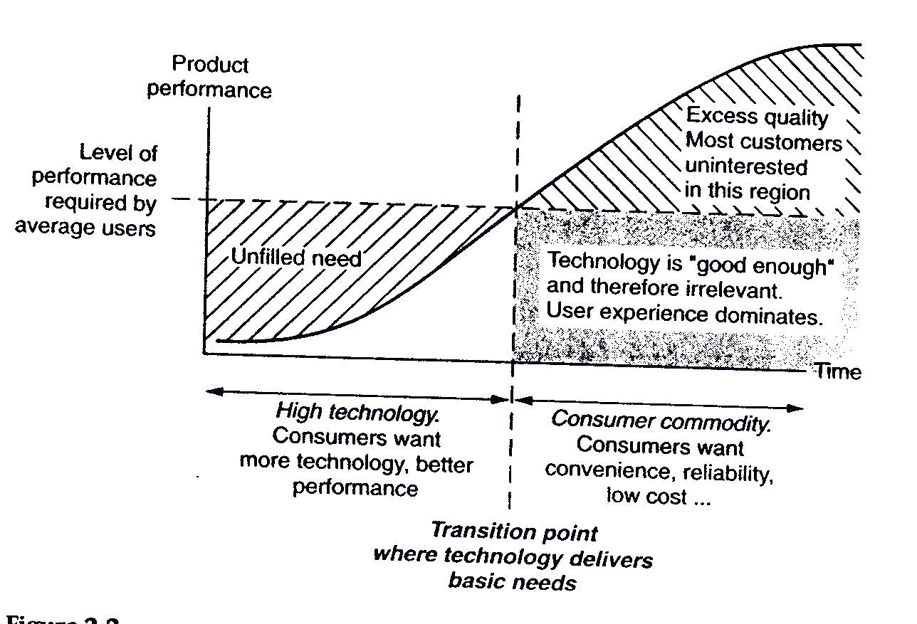
Needs-Satisfaction Curve of a Technology
Figure scanned from Norman.
Adapted from Christensen.
Notes:
Figure 2.2 (p. 32) of Norman.
Caption: The needs-satisfaction curve of a technology. New technologies start out at the bottom left of the curve, delivering less than the customers require. As a result, customers demand better technology and more features, regardless of of the cost or inconvenience. A transition occurs when the technology cannot satisfy the basic needs. (Modified from Christensen[1997].)
Norman: Don Norman.
The Invisible Computer: Why Good Products Can Fail, The Personal Computer Is So Complex, And Information Appliances Are the Solution.
The MIT Press, 1999. ISBN 0-262-64041-4 (paper back).
©1998 by the author.
Christensen: C. M. Christensen.
The Innovator’s Dilemma: When New Technologies Cause Great Firms to Fail.
Harvard Business School Press, 1997.
(citation from page 284 of Norman).

Slide 13
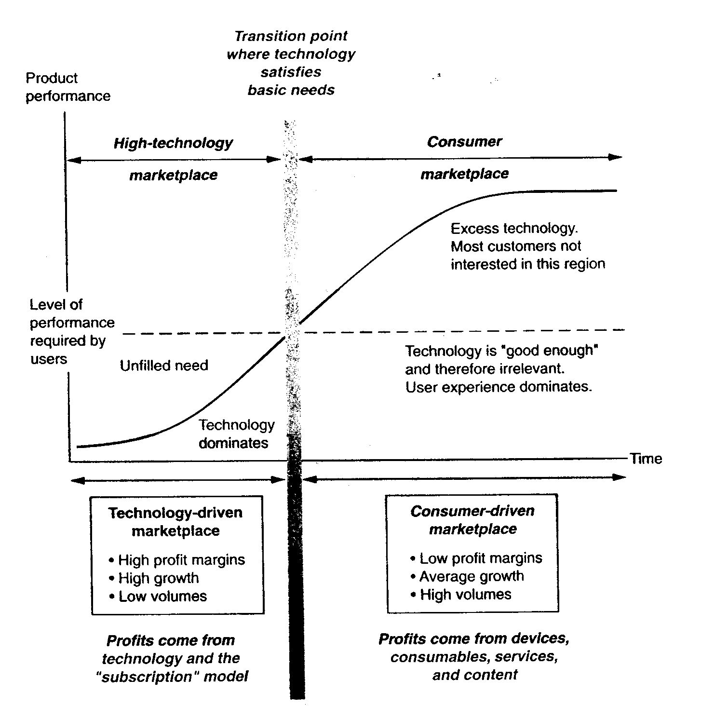
D. A. Norman
Notes:
Figure 12.1 (p. 251) of Norman
Caption: The business story accompanying the transition from a technology-centered market to a consumer-centered one. When technology reaches the point that it satisfies user needs, consumers no longer seek the best technology; they seek the most convenient one, the one with the most satisfactory user experience, the lowest cost, and the highest reliability. In some cases, they seek prestige. Brand name and reputation become major selling factors. Profit margins drop, but sales volumes rise; the entire business structure changes. As a result, the company itself must change if it is to survive the transition.
See also page 196 (final paragraph):
‘The usability of all technologies is poor whenever the power and performance of the technology fall below the level the required by the users. Here is where the device is difficult, for the user needs numerous controls and adjustments to compensate for the impoverished technical abilities of the device. As the technology matures, however, it can simplify the activity from the user’s point of view, even if at a cost in complexity for the technology itself.’

Slide 14
Range of HCI
  Broad
  Automobiles, manufacturing, assembly, business offices, kitchens
  Traditionally work only, but now leisure too
Notes:
2. Remit of Human Factors: Although historically concerned with work setting, HF is now concerned with the usability of all tools, objects, environments, etc, including objects and environments used for leisure activities, e.g. video interfaces, movie theatres, chain restaurants, etc.

Slide 15
Priorities in HCI
Centralise the user
But economics and politics matter
Trade-offs
Notes:
3. Priorities in Human Factors: A priority is consideration of users’ physical, behavioural and information processing characteristics and requirements.
Experience has shown that failure to deal with such characteristics can lead to wasted functionality, user frustration, inefficient practices, discomfort and error-prone activity.
However, much of HF work is a trade-off between considering the user and economic and political constraints.

Slide 16
One Level of Interaction
Organization’s
Goal
Social
system
Technical
system
Work

Slide 17
A Deeper Level of Interaction
Work
People
Technology

Slide 18
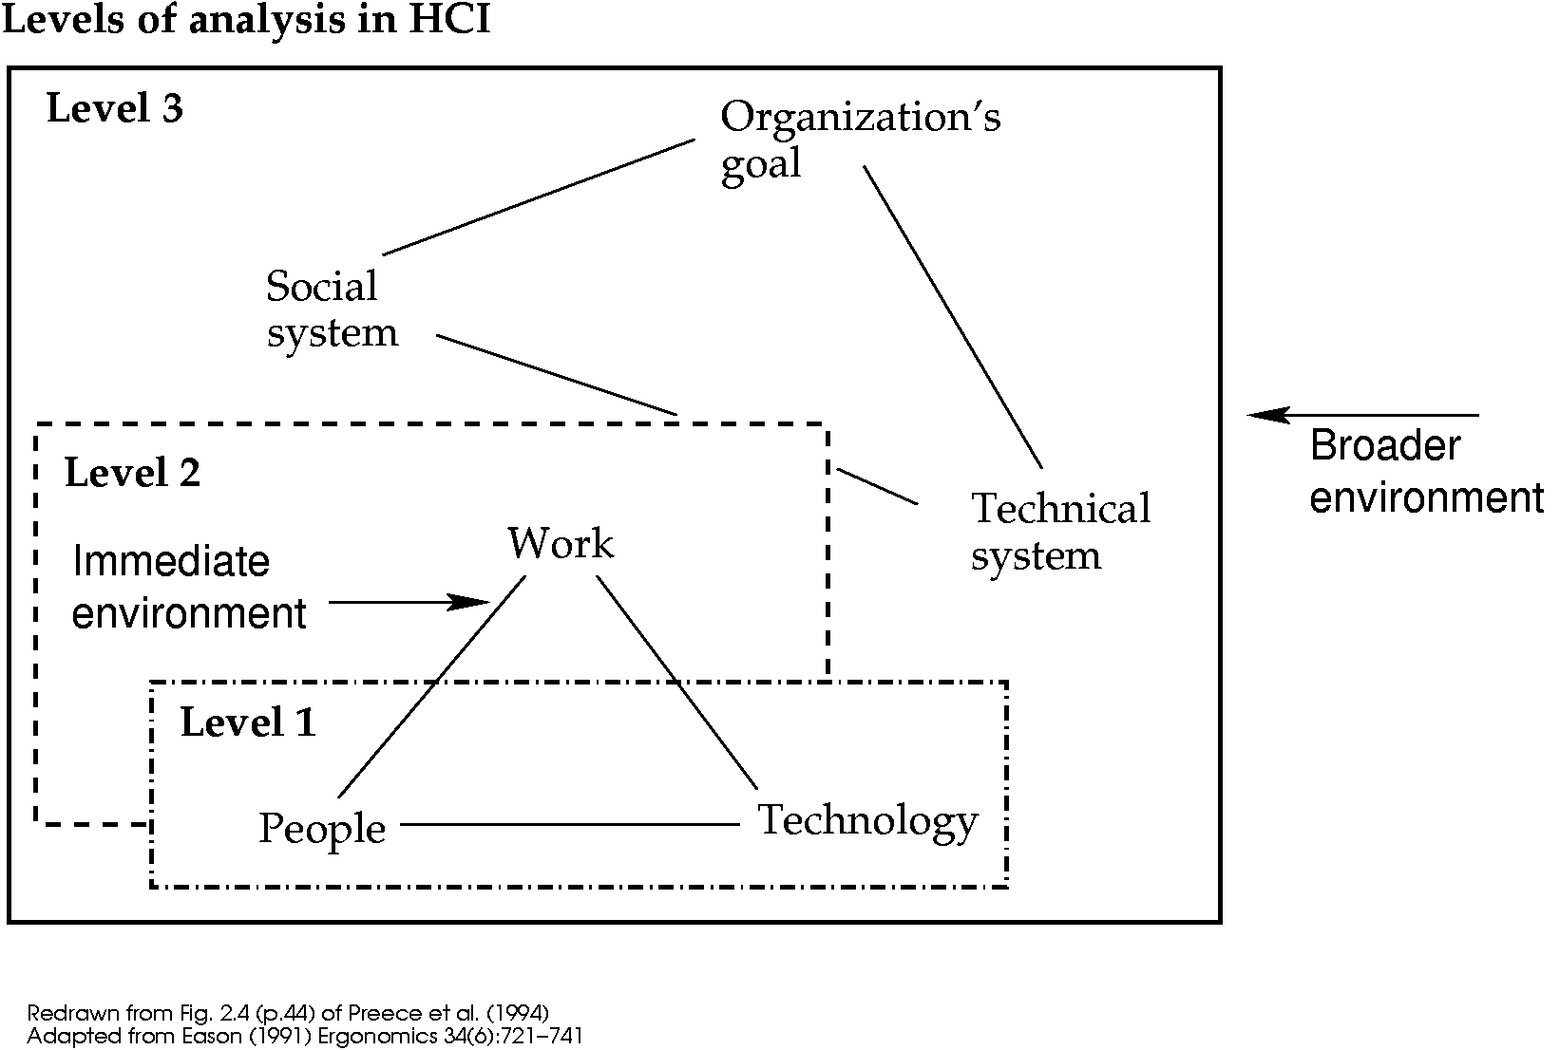
The Levels Combined*
*K. D. Eason
Notes:
Figure redrawn from Figure 2.4 of Preece et al. (2004) (which is an adaptation of a figure of Eason’s).
Full citations are in notes at start of slides

Slide 19
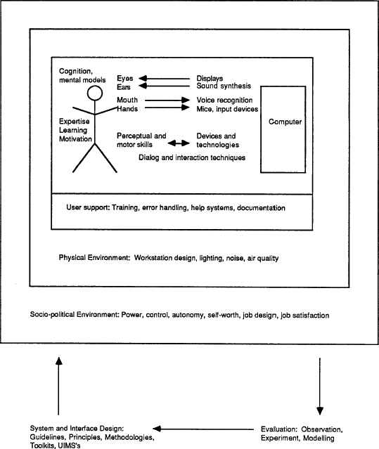
R. Baecker
Notes:
Ronald Baecker (1989, January).
A vision of education in user-centered system and interface design.
SIGCHI Bulletin 20(3) : 10-13. (Figure is from page 11).
<URL: http://doi.acm.org/10.1145/67900.67901>.
(Diagram created by A.-B. Graff under Dr. Baecker’s supervision.)

Slide 20
II. When & How to Apply HCI?
So what do we do with this world view?
  What do HCI experts produce?
And when can we apply HCI knowledge?

Slide 21
Items of Production
Models
Principles
Guidelines
Standards
Methods
Notes:
4. Products of Human Factors:
Whilst HF studies are aimed at evaluating particular equipment and work space layouts (e.g. kitchen layout, display design, work surface heights, chair design, computer interfaces, aircraft cockpit layouts and so on), a more general aim is to develop principles (list from Norman, 1988) and models (e.g. the Model Human Processor, Card, Moran and Newell, 1983) about how people interact with their environment and how that interaction affects their behaviour.
These principles can be used to derive performance predictions for the development of design guidelines (an example from Newman and Lamming, 1994) and legally enforceable standards (an example from Pheasant, or more information about different organisations which deal with standards) The evaluation, analysis and synthesis techniques are all methods which are also a product of human factors.

Slide 22
Standards?
Concerned with
  Human adaptability
  Human variability
Legally enforceable
E.g. see Preece et al. (1998)
  Chapter 25
Notes:
Preece et al.: Human-Computer Interaction by J.P., Yvonne Rogers, Helen Sharp, David Benyon, Simon Holland, Tom Carey. © 1994 The Open University. Published by Addison-Wesley.
Chapter 25

Slide 23
Standards?
Concerned with
  Human adaptability
  Human variability
Legally enforceable
E.g. see Stone et al. (2005)
  Chapter 9
Notes:
Debbie Stone, Caroline Jarrett, Mark Woodroffe, and Shailey Minocha
User Interface Design and Evaluation
Morgan Kaufmann Publishers (An imprint of Elsevier, Inc.)
ISBN 0-12-088436-4
©2005 by The Open University

Slide 24
Guidelines
Predictive and offer some general guidelines for making design decisions
E.g. Smith and Mosier; Preece; Norman
  ‘Adopt a consistent organisation for the location of various display features, insofar as possible, for all displays’
  See Heim, 2008 (chapter 6 & Appendix B)
Notes:
S&M: A Design Evaluation Checklist for User-System Interface Software By S.L. Smith and J.N. Mosier. Oct. 1984 (National Technical Information Service (USA) report #ESD-TR-84-358/NTIS document number AD A158 599)
Stone: vide infra
Norman: UCD?

Slide 25
Guidelines
Predictive and offer some general guidelines for making design decisions
E.g. Smith and Mosier; Preece; Norman
  ‘Adopt a consistent organisation for the location of various display features, insofar as possible, for all displays’
  See Preece et al., 1998 (chapter 24)
Notes:
S&M: A Design Evaluation Checklist for User-System Interface Software By S.L. Smith and J.N. Mosier. Oct. 1984 (National Technical Information Service (USA) report #ESD-TR-84-358/NTIS document number AD A158 599)
Preece: vide infra
Norman: UCD?

Slide 26
Principles
Predictive
Specify principles which can underpin design decisions
Do not specify the limits of human capabilities (unlike standards)
More general than guidelines
    E.g. Norman: feedback, consistency, visibility, understanding

Slide 27
Approaches to HF
Classical ergonomics: lab-based
Error ergonomics: zero defects error store
Systems ergonomics: interaction dyad
User centred design: contextual issues
Human centred design: contextual and broader political issues
Notes:
Classical ergonomics: also called ‘interface ergonomics’. The interface referred to is the person/ machine interface of controls and displays and the principle contribution of the human factors expert is the improved design of dials and meters, control knobs and panel layout.
Error ergonomics: The is the study and explanation of human error in systems. The ‘zero defects’ approach assumes that human error is the result of inadequate motivation, c.f. the examples of accidents and error attribution.
Systems ergonomics: This approach developed in the USA in the 1950s, and takes a more holistic approach to user-system dyad. The user and the system are seen as a single interacting system which is placed within a work context. The approach differs from user-centred design as the designers and human factors experts still view the user as just one part of the system, whereas user-centred design focuses more on the user’s needs and perspective than those of the system, tasks and activities per se.
User centred design: (cf. Norman, 1988) involves focusing on the user’s needs, carrying out an activity/task analysis as well as a general requirements analysis, carrying out early testing and evaluation and designing iteratively.
Socio Technical Systems design: see Clegg.

Slide 28
New Approaches to HF
Activity theory
  Actions are extensions of thought,
  Hierarchical structure of tasks and subparts,
  O-O
Agile usability
  Deployment and evaluation
  Not rapid prototyping, more like releasing betas
Embracing users as designers

Slide 29
Concepts in HF (1 of 3)
Functionality + usability + learnability = usefulness
functionality
efficiency
maintainability
reliability
Notes:
Functionality: What something does.
Efficiency of a system: can be measured through the use of resources such as processor time, memory, network access, system facilities, disk space and so on.
Maintainability: as systems get larger and more costly, the need for a life-long time in service increases in parallel. To help achieve this, designs must allow for future modification.
Reliability is concerned with the dynamic properties of the eventual system and involves the designer in making predictions about behavioural issues.
We need to know if the system is going to be
complete (in the sense that it will be able to handle all combinations of events and system states),
consistent (in that its behaviour will be as expected and will be repeatable, regardless of the overall system loading at any time) and
robust (when faced with component failure or some similar conflict (for example, if the printer used for logging data in a chemical process-control plant fails for some reason),
this should not be able to ‘hang’ the whole system but should be handled according to the philosophy summed up in the term graceful degradation. [Note ends]

Slide 30
Concepts in HF (2 of 3)
Usability
  How easily functionality can be utilised by users, considering anthropometrics, core tasks, cognitive issues, social context, etc.)
  Appropriate functionality
  Appropriate efficiency
  Visual clarity (contributes to explicitness)
Notes:
Usability: but what is it?

Slide 31
Concepts in HF (3 of 3)
Consistency
  (Contributes to explicitness)
Informative feedback
  (Contributes to explicitness)
Flexibility and control
Error prevention and control
User guidance and support
All aid learnability

Slide 32
Definitions of Usability
Eason (1984) ‘the major indicator of usability is whether a system or facility is used’
ISO: ‘the usability of a product is the degree to which specific users can achieve their goals within a particular environment, effectively, efficiently, comfortably and in an acceptable manner’
Notes:
Most important concepts: FUNCTIONALITY, USABILITY, LEARNABILITY

Slide 33
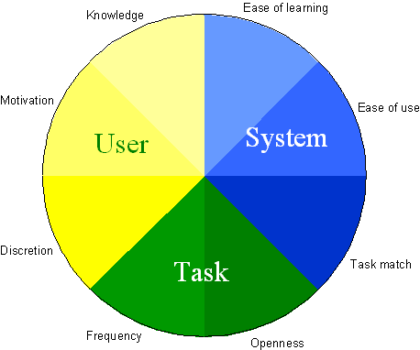
Eason’s Usability*
Notes:
* Image by Simon Crowle (<URL: http://dec.bournemouth.ac.uk/staff/scrowle/Teaching/LectureLibrary/HCIIntro/images/EasonUsability.gif>, 09 October 2001)

Slide 34
some other
Definitions of Usability
ETSI: performance (objective measures) & attitude (likeability — subjective measures)
Shackel (1991): effectiveness, learnability, flexibility and attitude
Booth (1989) usefulness — effectiveness and ease of use, learnability and attitude and likeability

Slide 35
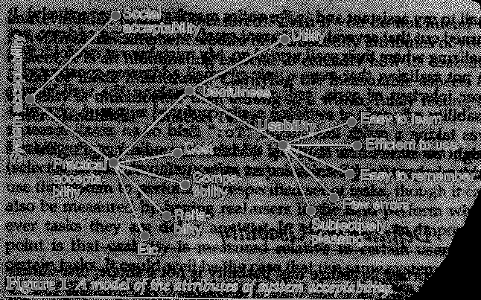
Nielsen’s
System Acceptability
Notes:
Animation: 1 click
Notes:
embedded,
factorial (or categorical)
Compare to the simple concept of ‘user friendly’
Figure 1 (p.25)
Jakob Nielsen. Usability Engineering.
Morgan Kaufmann Publishers, Inc. ©1993 by Academic Press.
ISBN 0-12-518406-9, LCC QA76.9.U83N54.

Slide 36
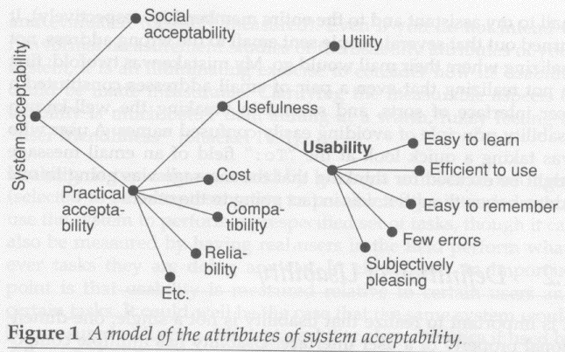
Nielsen’s
System Acceptability
Notes:
Only for handout

Slide 37
Useful Terms (1 of 2)
Anthropometrics, biomechanics
Behavioural
Cognitive
Psycho-social
Socio-technical

Slide 38
Useful Terms (2 of 2)
‘Core’ tasks
Stakeholders
Users, operators
Designers
Subjects
Participants

Slide 39
Common Problems in Contemporary HF
Size of systems
Cognitive constraints: black box problems
Social and organisation factors: communication problems
Problems with the design and construction of systems
Problems of automation
Notes:
Size of systems: often large
Cognitive constraints: black box problems: users don’t get adequate feedback of what is going on, lack of visibility. See Norman for examples and also note the crashes which will be discussed in lectures.
Social and organisation factors: communication problems
Problems with the design and construction of systems
Problems of automation

Slide 40
HF needs to go beyond recommendations about the design of technology
It has to offer a conceptual basis for these recommendations
E.g. psychological and psycho-social factors

Slide 41
Useful Heuristics
For Reading
  To what end and on whose behalf does the HF professional analyse an object or someone’s task performance?
  What is the purpose of the analysis?
  On whose behalf?
  Who are the stakeholders?
  What are the conditions of emergence?
  What is the view of the worker?
  (e.g. U.S. Army doesn’t bother with designing as much as developing because they have the resources (time and labour) for training)?

Slide 42
III. More Reasons for Interest in Usability:
Hardware environment
Types/sophistication of users
New applications

Slide 43
Recent Hardware Changes
Ubiquitous computing
  PDAs (handhelds)
  Embedded computers
Network-enabled devices
  Wireless access
  Rise of the Internet

Slide 44
User Changes
Computing professionals vs. Discretionary users
Proportion has changed: more discretionary users
Users are more sophisticated and demanding

Slide 45
Application Changes
1950’s
batch text
CAD
computational s/w
meteorological
banks
1970’s
cheaper
graphics
improved
printers
small
business
computing
1980’s
1990’s / forward
personal computer apps
(e.g. spreadsheets, word
processing)
bit-mapped graphics
hypertext
multimedia
groupware
Notes:
Applications that changed over time and affected hci:
1950's Graphics Batch Text Text
CAD and
Graphics
1970's cheap
graphics
1980's bit-mapped Wysiwyg
color Hypertext
graphics

Slide 46
Later Application Changes
Adaptive and personalized systems
  Increased complexity
  Privacy concerns
  Desire for content and capabilities
Electronic commerce
Social and collaborative systems

Slide 47
Recent Changes
Haptic input and output
  Wii
  RumblePak
  iPodTouch
Context of use much more important
  Mobile applications
  Privacy concerns

Slide 48
Related Articles
Brad Myers. 1994. Challenges of HCI design and implementation. interactions v.1, n.1 (Jan. 1994), pp.73‒83.
  <URL:http://doi.acm.org/10.1145/174800.174808>.
Katie Minardo Scott. 2009. Is usability obsolete? interactions v.16, n.3 (May 2009), pp.6‒11.
  <URL:http://doi.acm.org/10.1145/1516016.1516018>.

Slide 49
Some Major Concepts in this Lecture
HCI and Human Factors (HF)
Why HCI studies are important
Priorities of HCI / Human Factors
User-Centred Design (UCD)
The Interaction Dyad
Needs Satisfaction Curve of a Technology
Efficiency, Effectiveness, Satisfaction

Slide 50
Other Major Concepts in this Lecture
Usability
  Multiple definitions
  Multiple factors
  Functionality
Consumer commodity
Hardware changes
Items of Production
  Standards
  Guidelines
  Principles
How HCI/HF is done
User changes
  Discretionary users

Slide 51
Potential Exam Questions
From this lecture
If someone says ‘____ is a great product for someone else to use because it has all of the necessary functionality that they need, and it is user-friendly too.’
Why should you doubt their credibility?

Slide 52
Further Potential Questions
What does the ISO definition of usability say?
Some definitions of usability include factors (or measures) that are not in the ISO definition. Which of those factors are particularly important in the following scenario?
What are the 3 essential components of any definition of usability?

